Slide 1
Fortnite – Loot Lake
By. Faith, Sam, and Dylan

Slide 2
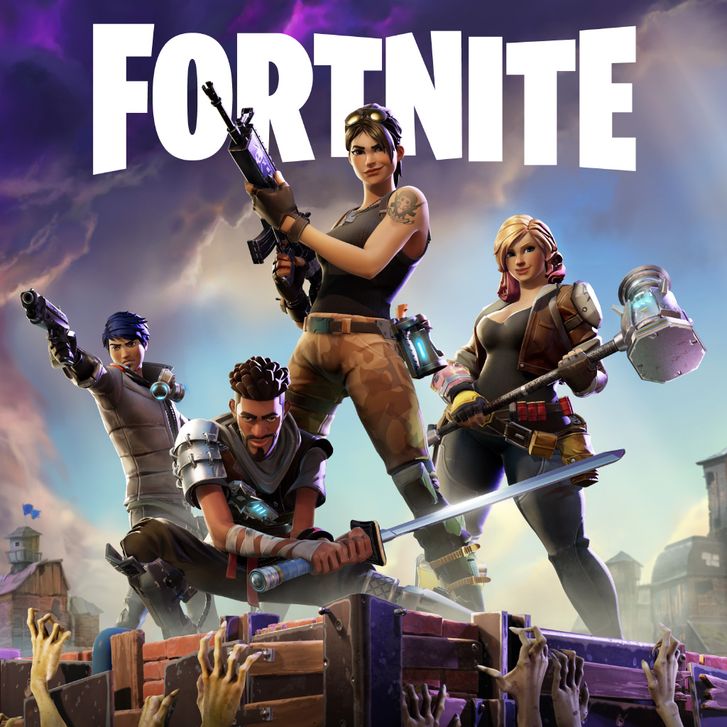
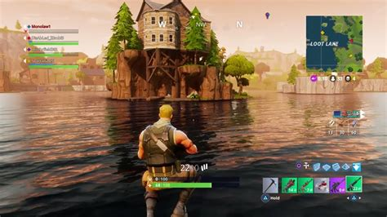

Slide 3
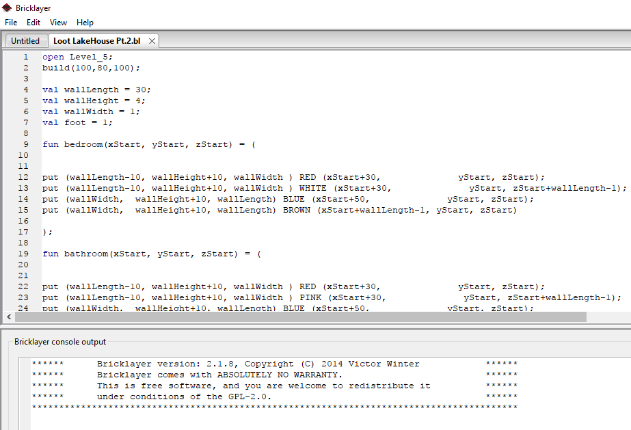

Slide 4
